Slide 1
EDES 301 PCB Project
Eleanor Tucker
Due 05/06/2025 @ 11:59pm

Slide 2
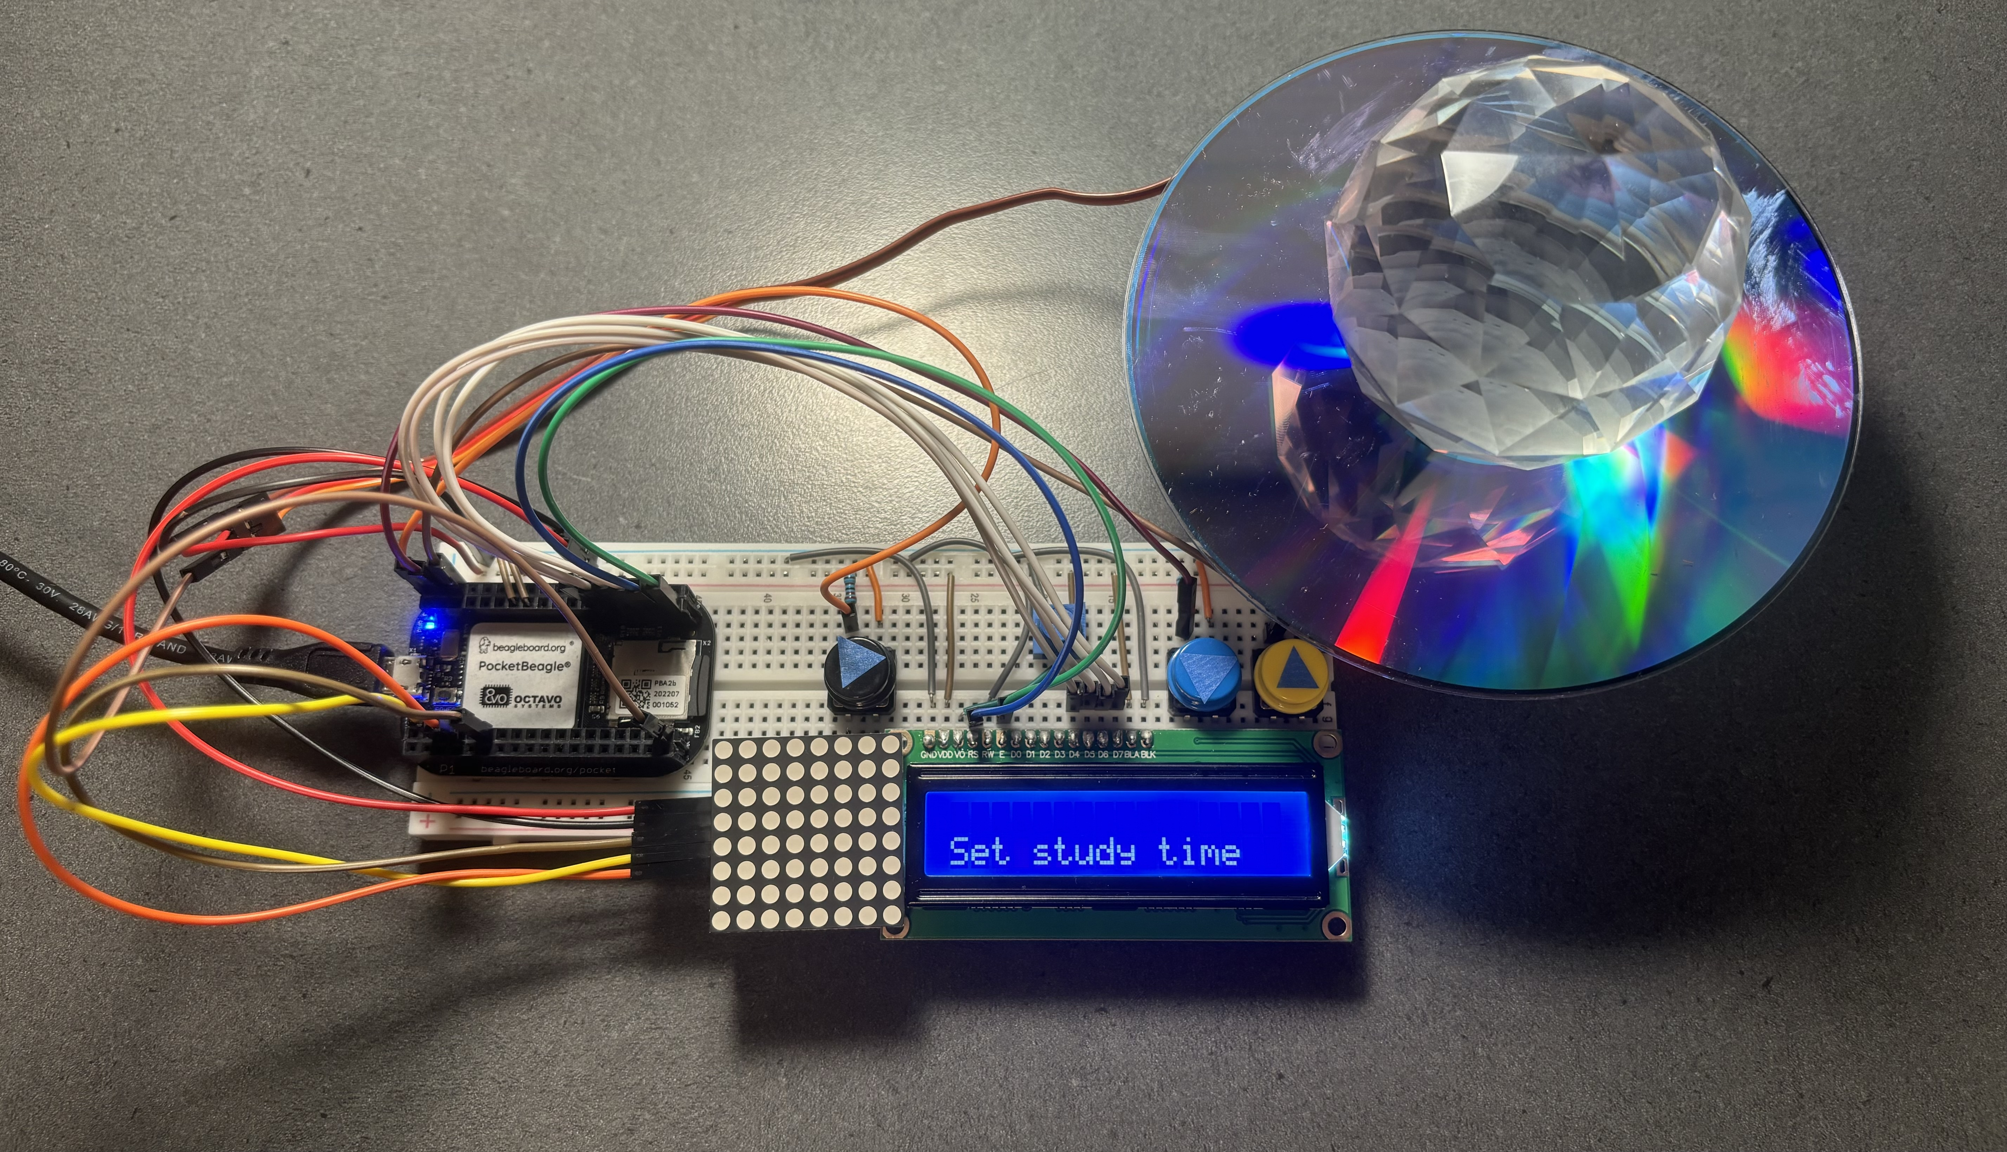
Background Information
Designing a PCB for the Prism Pomodoro device made for project 1
Hardware:
Continuous rotation Servo
Three buttons
16x2 LCD screen
8x8 LED matrix

Slide 3
System Block Diagram – Prism Pomodoro
PocketBeagle
SPI
8x8 LED matrix
PWM
Servo continuous rotation motor
GPIO
16x2 LCD screen
GPIO
Buttons

Slide 4
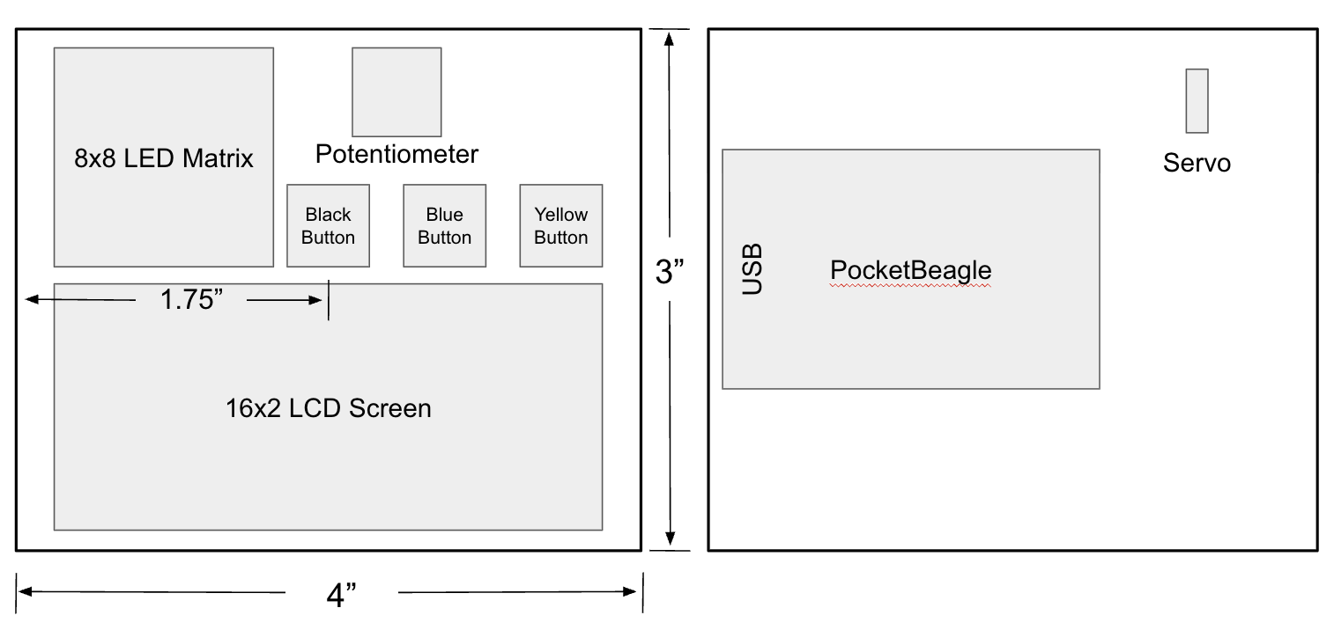
Mechanical Drawing
FRONT
BACK

